Slide 1


SIMATS ENGINEERING
Pipeline Corrosion Inspection
COURSE CODE:DSA0205
COURSE NAME:COMPUTER VISION WITH OPENCV
PRESENTED BY:
Y.BHAVYA SRI

Slide 2
ABSTRACT
Pipeline Corrosion Inspection is a critical process for ensuring the safety, reliability, and longevity of pipelines used in oil, gas, water, and chemical transportation. Corrosion can lead to leaks, structural failures, environmental damage, and significant economic losses if not detected at an early stage. This project focuses on developing an efficient inspection workflow using digital image processing and artificial intelligence (AI) techniques to identify and analyze corrosion defects. The process begins with collecting inspection data using cameras, drones, robotic crawlers, or in-line inspection (ILI) tools. The acquired images are then preprocessed through noise removal, contrast enhancement, and image normalization to improve their quality. Expert annotation is performed to identify corrosion regions, classify defect types, and generate accurate labels for model training. The annotated data is securely stored in a centralized database for future analysis and AI model development. Machine learning and deep learning algorithms can then be applied to automatically detect corrosion, estimate its severity, and support predictive maintenance. This approach improves inspection accuracy, reduces manual effort and maintenance costs, enhances operational safety, and enables timely decision-making for effective pipeline integrity management.

Slide 3

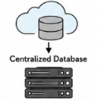



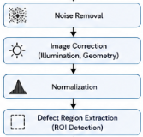
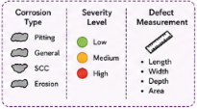
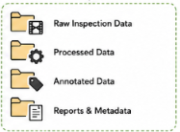



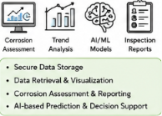




DATA COLLECTION
DATA PREPROCESSING
CORROSION ANNOTATION
DATA STORAGE &ANALYSIS
Corrosion/Defect Annotation
Store & Manage Data
Acquire Pipeline Data
Preprocess & Enhance Data
Expert Annotation
In-Line Inspection(ILI)
Tools/Robotic Crawlers
Raw Inspection Data
Processed Data
Analysis & Application
Annontated Dataset

